Slide 1
Numerical Computation
Darrell Long
CSE 13S
Joseph-Louis Lagrange

Slide 2
Basic Arithmetic Operations
Computers can only do basic operations such as addition, subtraction, multiplication and division.
Multiplication is shift and addition,
Division is shift and subtraction,
Addition is little more than exclusive-xor
What about trigonometric functions?
Some processors do them internally, but they are still using the basic operations.
What about integrals? What about transforms? What about …?
These are in the realm of numerical methods.

Slide 3
Absolute Value
That’s an easy one: abs(x) = if x < 0 then –x else x
Should I just write the code?
It depends… Most mathematical libraries have families of absolute value functions that depend on the data type.
It may be faster to let the compiler or the mathematics library do it, since as in the case of floating point it may be just clearing a bit.

Slide 4
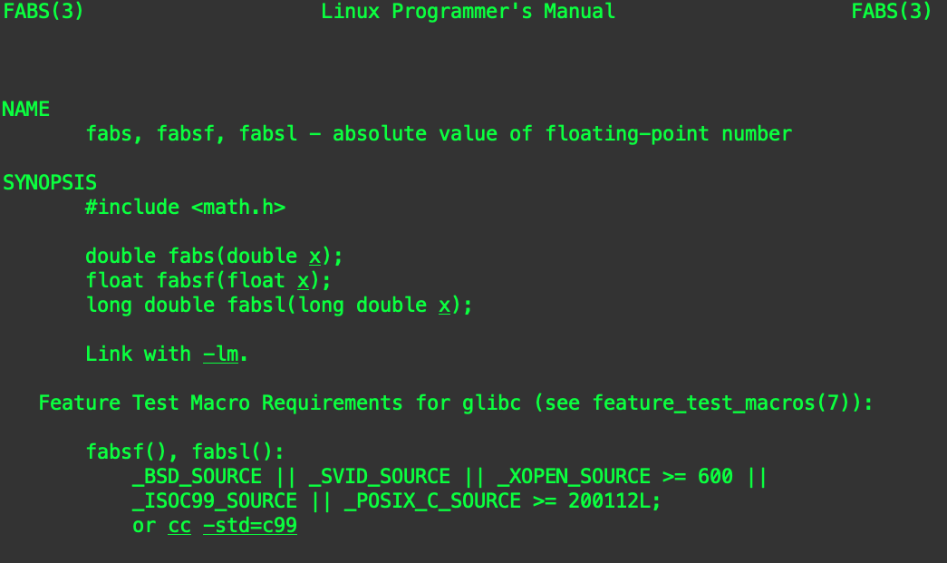
Check the man page!

Slide 5
Can I just use the library?
In general, yes, it is best to use the library.
The library should be designed to be:
Careful with numerical precision,
Fast, and portable.
That being said, it is important for you to have some understanding of what goes into implementing mathematical functions.
Remember: There is no magic!

Slide 6
Trigonometric Functions

Slide 7

Taylor Series
If $f(x)$ is a real or complex valued function, and it is infinitely differentiable then:
$f\left(x\right)=\sum_{n=0}^{∞}{\frac{f^{\left(n\right)}\left(a\right)}{n!} {(x−a)}^{n}}$
For example, consider $e^{x}$ centered at $a=0:$
$e^{x}=1+\frac{x}{1!}+\frac{x^{2}}{2!}+\frac{x^{3}}{3!}+…, −∞<x<∞$
Brook Taylor

Slide 8
Increasingly Better Approximations
Each derivative adds a term to the approximating polynomial.

Slide 9

$$e^{x}$$
Has the simplest Taylor series.

Slide 10
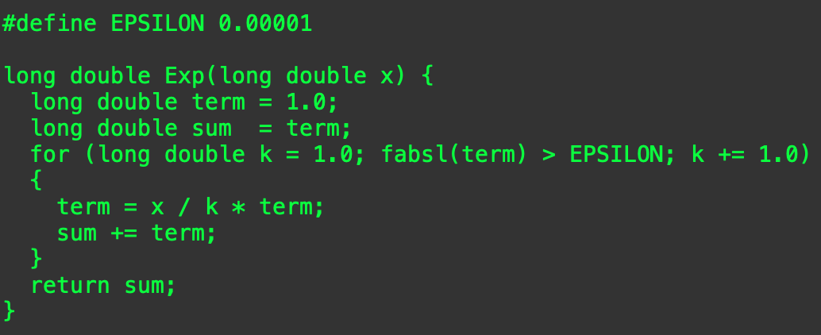


Computing $e^{x}$
$k!> x^{k}$ for all $x$, eventually (when $k$ gets large enough), so:
$\frac{x^{k}}{k!}$ gets smaller with each step (again, eventually)
We can stop when it gets small enough that it is “good enough” for our computation.

Slide 11
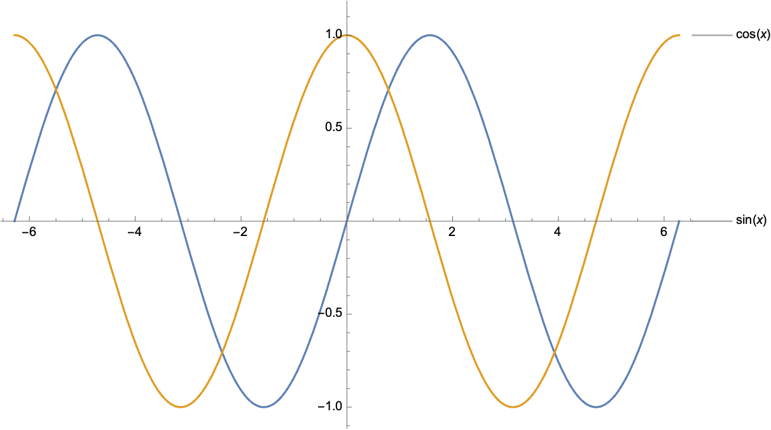

$\sin\left(x\right)$ and $cos⁡(x)$

Slide 12


Computing $sin⁡(x)$
What do we know about $sin⁡(x)$?
It is:
Periodic on $[−2π, 2π]$, meaning that $\sin\left(9π\right)=\sin\left(π\right)$
Infinitely differentiable, making a good candidate for a Taylor series.
Where shall we center it? How about right in the middle, at zero:
$\sin\left(x\right)=x −\frac{x^{3}}{6}+\frac{x^{5}}{120}−\frac{x^{7}}{5040}+\frac{x^{9}}{362880}−\frac{x^{11}}{39916800}+O(x^{12})$
Is that good enough?
It depends on how close $x$ is to zero.
In general, you will need more terms.

Slide 13
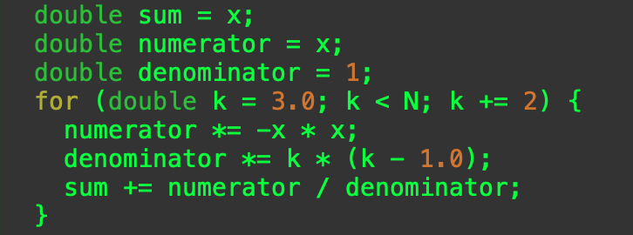

Computing the Terms
We skip even numbered terms, and
The sign of the terms alternate.
Before computing $sin⁡(x)$ do not forget to remove extra factors of $2π$.
How many terms do we need?

Slide 14
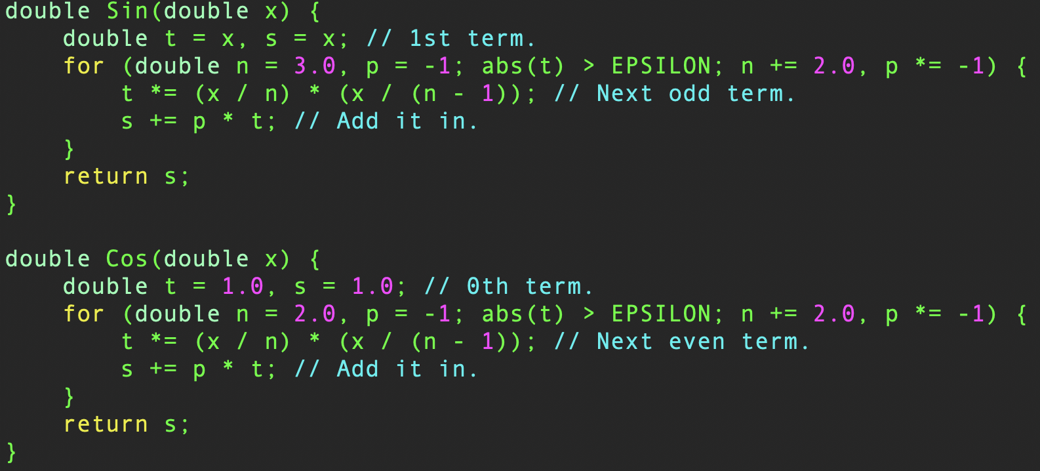
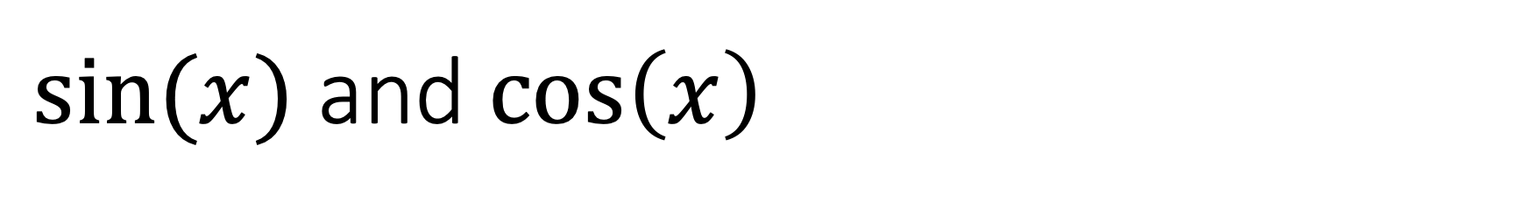
$sin⁡(x)$ and $\cos\left(x\right)$

Slide 15
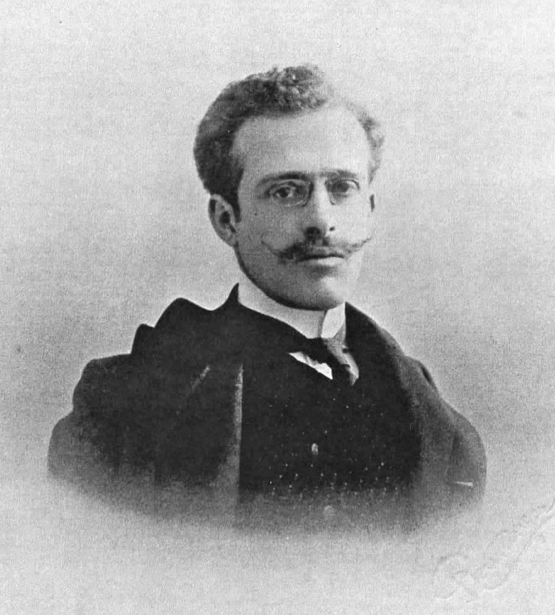
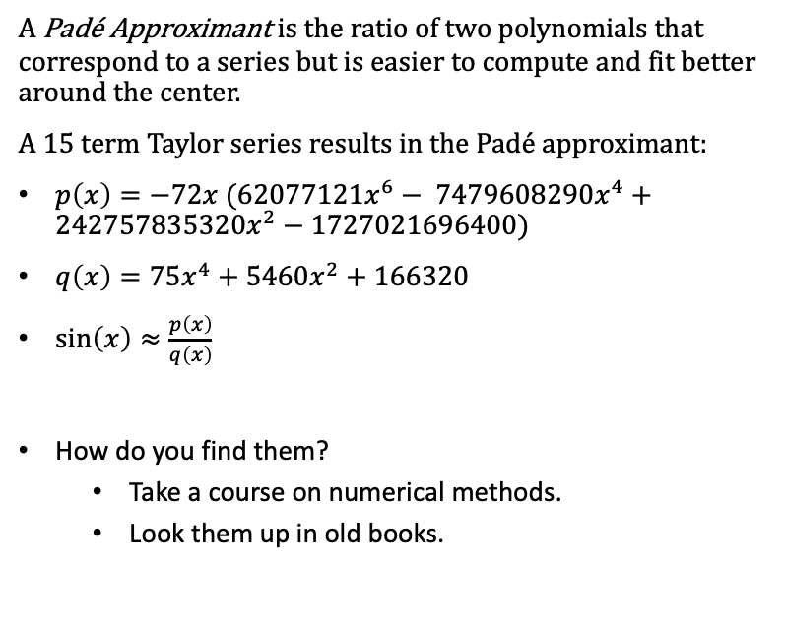
Padé Approximants
A Padé Approximant is the ratio of two polynomials that correspond to a series but is easier to compute and fit better around the center.
A $15$ term Taylor series results in the Padé approximant:
$p\left(x\right)=−72x (62077121x^{6}− 7479608290x^{4}+242757835320x^{2}−1727021696400)$
$q\left(x\right)=75x^{4}+5460x^{2}+166320$
$\sin\left(x\right)≈\frac{p\left(x\right)}{q\left(x\right)}$
How do you find them?
Take a course on numerical methods.
Look them up in old books.
Henri Padé

Slide 16
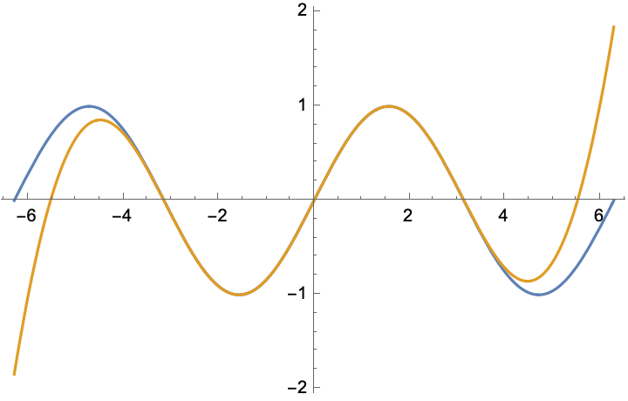

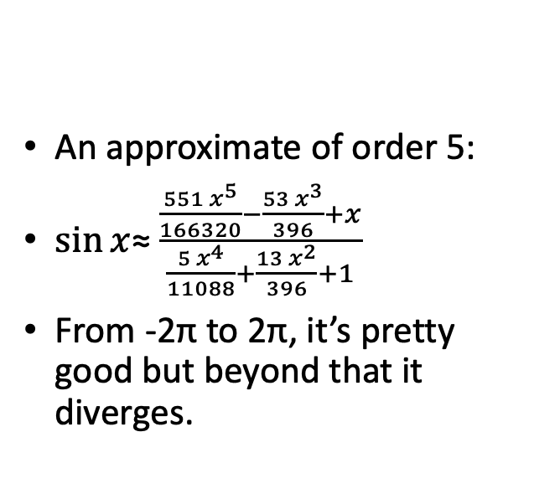
Example Padé Approximate for $\sin{x}$
An approximate of order 5:
$\sin{x}$≈ $\frac{\frac{551 x^{5}}{166320}−\frac{53 x^{3}}{396}+x}{\frac{5 x^{4}}{11088}+\frac{13 x^{2}}{396}+1}$
From -2π to 2π, it’s pretty good but beyond that it diverges.

Slide 17
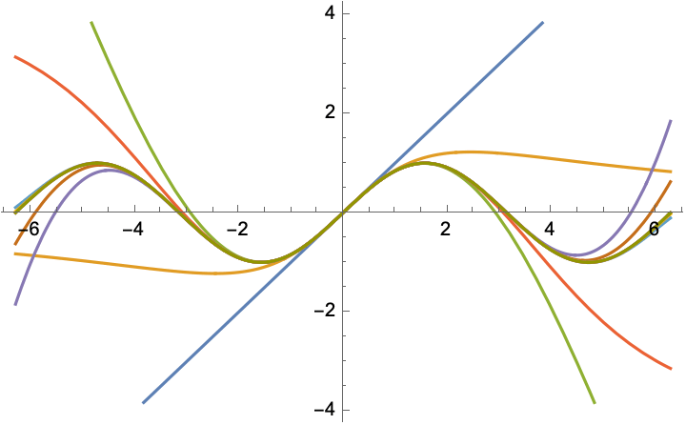
More terms make the approximation better

Slide 18
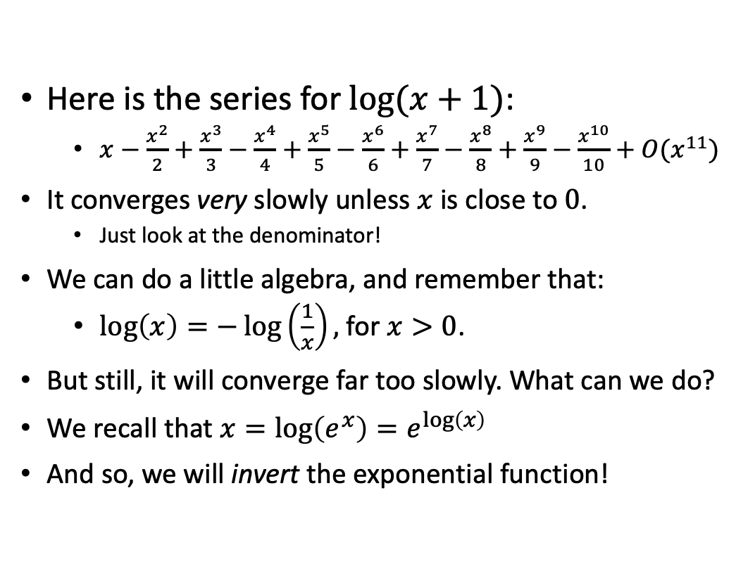
What happens if the series converges too slowly?
Here is the series for $log⁡(x+1)$:
$x−\frac{x^{2}}{2}+\frac{x^{3}}{3}−\frac{x^{4}}{4}+\frac{x^{5}}{5}−\frac{x^{6}}{6}+\frac{x^{7}}{7}−\frac{x^{8}}{8}+\frac{x^{9}}{9}−\frac{x^{10}}{10}+O(x^{11})$
It converges very slowly unless $x$ is close to $0$.
Just look at the denominator!
We can do a little algebra, and remember that:
$\log\left(x\right)=−\log\left(\frac{1}{x}\right),$for $x>0$.
But still, it will converge far too slowly. What can we do?
We recall that $x=\log\left(e^{x}\right)=e^{\log\left(x\right)}$
And so, we will invert the exponential function!

Slide 19

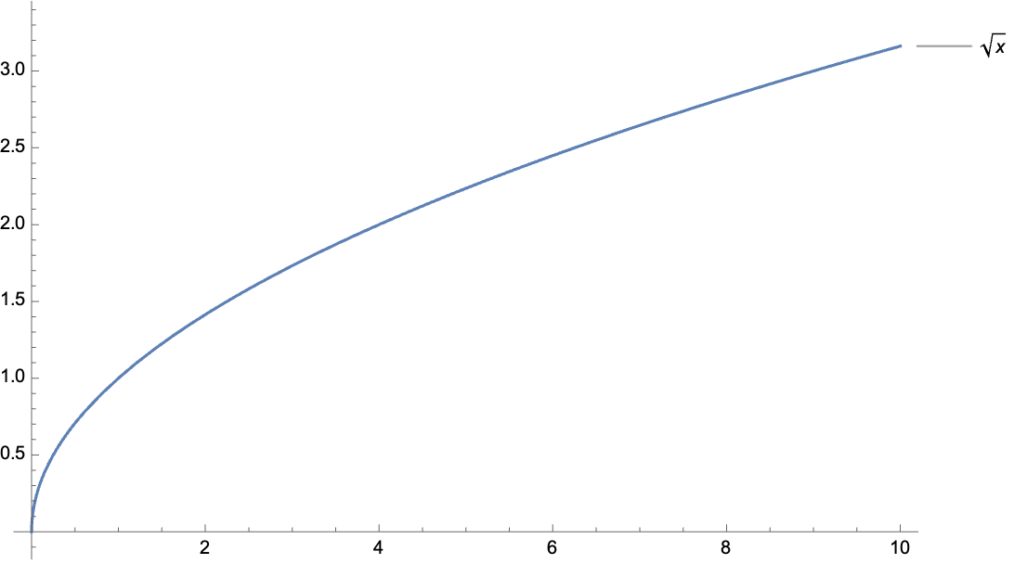

$$\sqrt{x}$$
Square root does not have a Taylor series.
So, what can we do?

Slide 20
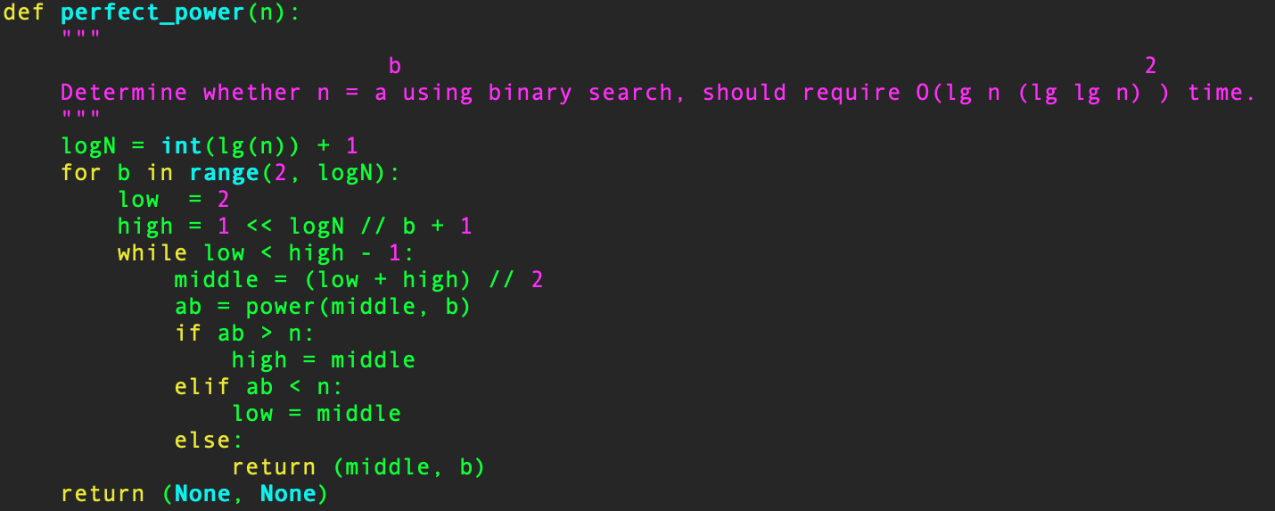
Binary Search
It is not always a bad idea.
But for differentiable functions, we can do a lot better!

Slide 21
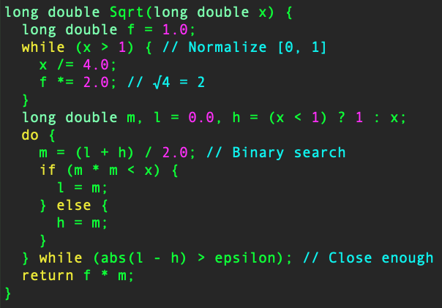
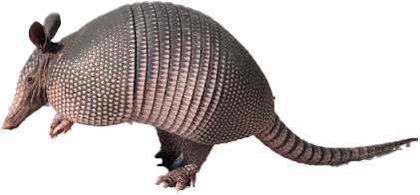

$$\sqrt{x}$$
Guess that it is in the middle.
Is the guess too small? Look in the larger half.
Is the guess too big? Look in the smaller half.

Slide 22

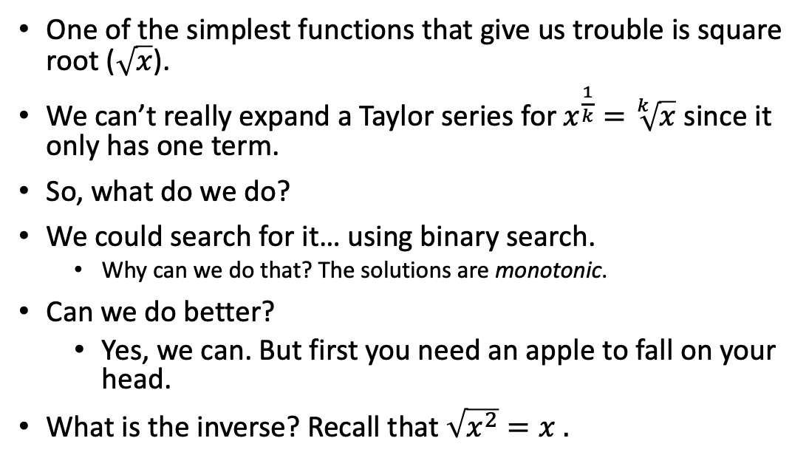
Inverting a Function
One of the simplest functions that give us trouble is square root ($\sqrt{x}$).
We can’t really expand a Taylor series for $x^{\frac{1}{k}}=\sqrt[k]{x}$ since it only has one term.
So, what do we do?
We could search for it… using binary search.
Why can we do that? The solutions are monotonic.
Can we do better?
Yes, we can. But first you need an apple to fall on your head.
What is the inverse? Recall that $\sqrt{x^{2}}=x .$

Slide 23
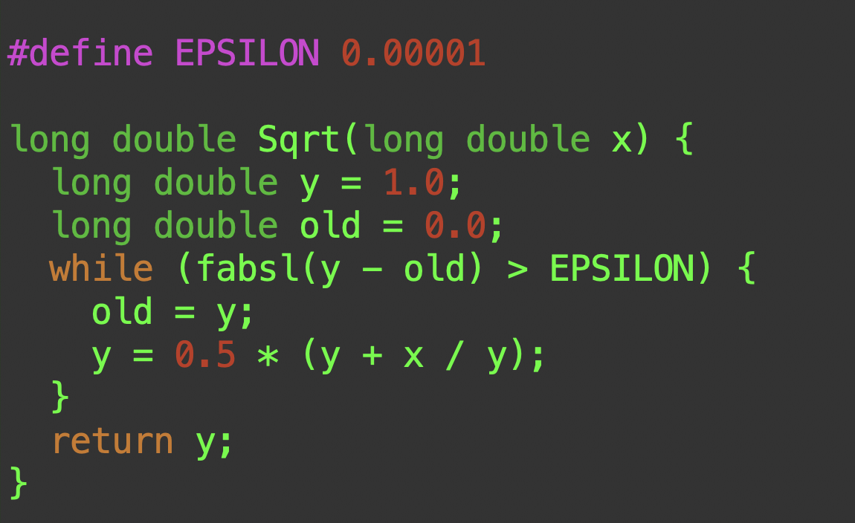
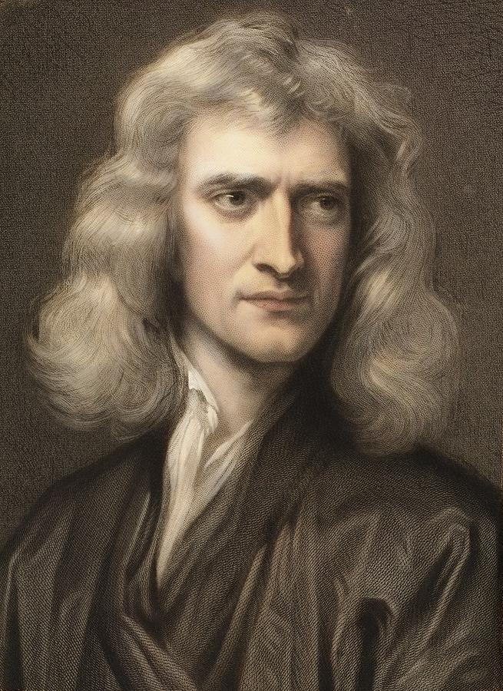


$\sqrt{n}$ using a Newton Iterate
Sir Isaac Newton comes to the rescue again.
We use this iterate:
$x_{k+1}=\frac{1}{2}(x_{k}+\frac{n}{x_{k}})$
As before, we iterate until the approximation is good enough.

Slide 24
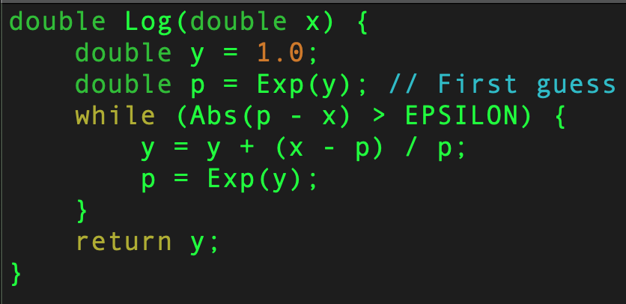


$log⁡(x)$ using Newton’s Method
Newton’s formula provides a linear approximation of the function.
Solve for $x_{n+1}$
$x_{n+1}=x_{n}+\frac{f\left(x_{n}\right)}{f^{′}\left(x_{n}\right)}$
Find the root of $f\left(y\right)=x −e^{y}$
We iterate this equation until our answer is close enough:
$y_{n+1}=y_{n}+\frac{x−e^{y_{n}}}{e^{y_{n}}}$
For details, ask your calculus professor!
You can get very deep very quickly!

Slide 25
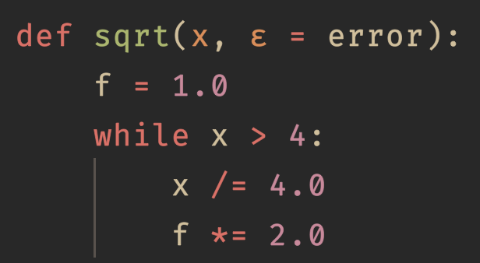
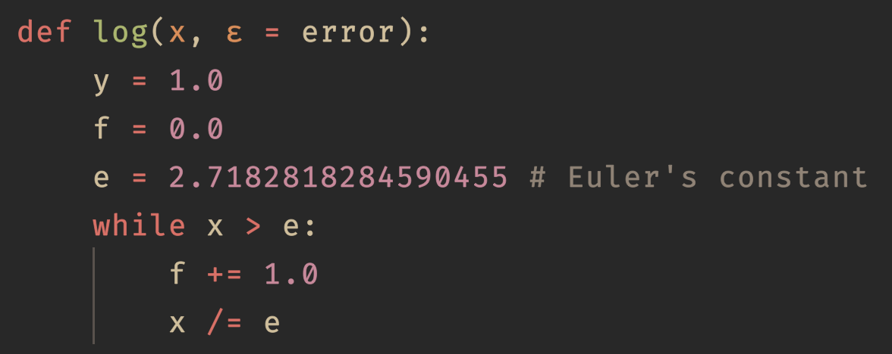

Scaling
$$\sqrt{4x}=2\sqrt{x}$$
$$log\left(y\right)=\log\left(x e^{f}\right)=\log\left(x\right)+\log\left(e^{f}\right)=f+log⁡(x)$$

Slide 26
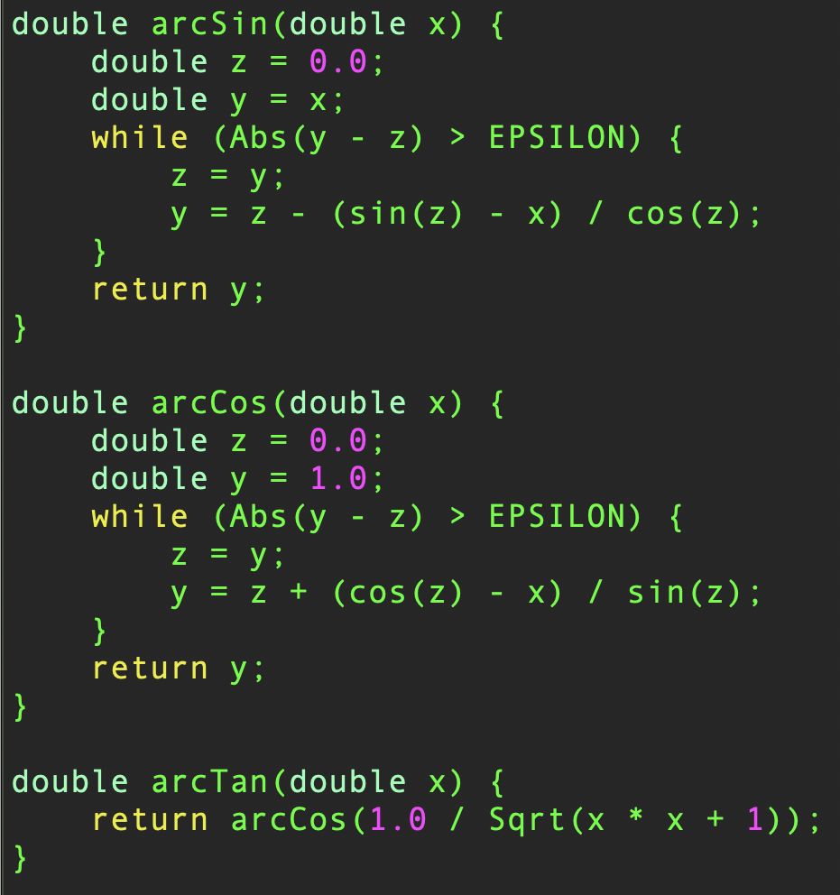
Inverse Trigonometric Functions

Slide 27
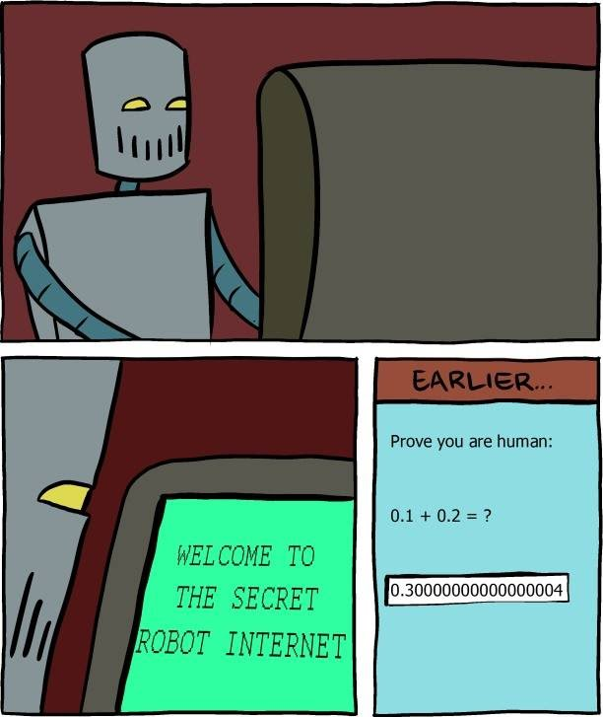
Floating-point Arithmetic
Normal mathematics:
Real numbers are exact.
Computer arithmetic:
Numbers are approximated.
Floating-point arithmetic results in rounding errors.
Calculations can require rounding to fit into a finite representation.
Results of floating-point arithmetic are also approximations.

Slide 28

Round-Off Errors
Errors occur when doing any calculation with floating-point.
Because rounding occurs to fit values into a finite representation.
Floating point $≠$ $ℚ$
IEEE 754 defines 5 standard rounding modes:
Round to nearest, ties rounded to nearest value with even significant digit (most common).
Round to nearest, ties rounded to value furthest from zero.
Round up (ceiling)
Round down (floor)
Round to zero (truncation)

Slide 29
Some Dangers of Floating-point Arithmetic
Addition and subtraction
Adding numbers of very different magnitudes can result in the digits of the number of smaller magnitude rounded away.
Subtracting numbers of very different magnitudes can also result in precision error.
Truncation errors can occur when shifting the mantissa.

Slide 30

Comparing Floating-point Numbers
Direct comparison of floating-point numbers should be avoided.
Comparisons that you expect to be true may not be due to round-off errors.
Can check if the absolute error is a small value.
$\left|x^{∗}−x\right|<ε$
Here, $x^{∗}$ is an approximation of $x$.
The small value difference is called epsilon ($ε$).
Relative error, unlike absolute error, is calculated considering $x$ itself.
$\frac{\left|x^{∗}−x\right|}{\left|x\right|}<ε$
It is the ratio of the absolute error of the approximated value with the exact value.

Slide 31
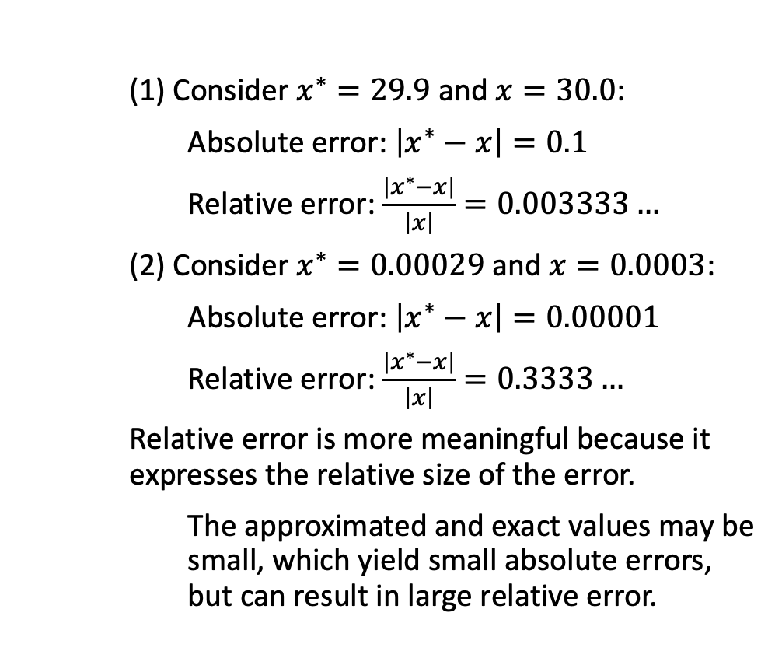
Why Relative Error is Meaningful
(1) Consider $x^{∗}=29.9$ and $x=30.0$:
Absolute error: $\left|x^{∗}−x\right|=0.1$
Relative error: $\frac{\left|x^{∗}−x\right|}{\left|x\right|}=0.003333…$
(2) Consider $x^{∗}=0.00029$ and $x=0.0003$:
Absolute error: $\left|x^{∗}−x\right|=0.00001$
Relative error: $\frac{\left|x^{∗}−x\right|}{\left|x\right|}=0.3333…$
Relative error is more meaningful because it expresses the relative size of the error.
The approximated and exact values may be small, which yield small absolute errors, but can result in large relative error.

Slide 32
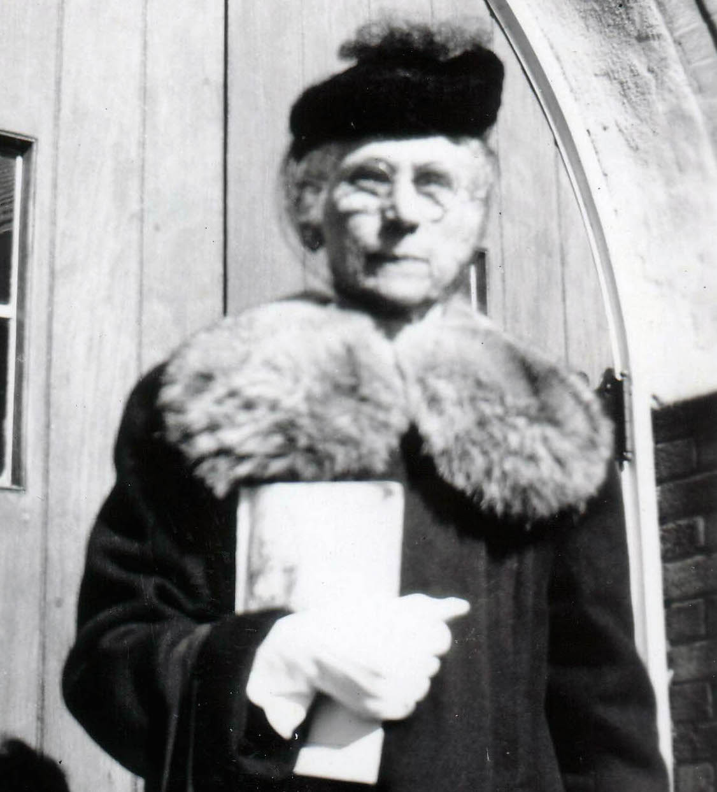
What do we know?
Floating point numbers are not real numbers.
We need to take care when working with floating point numbers due to limited precision.
For example, subtracting two numbers of very different magnitudes can lose precision.
A Taylor series can approximate an infinitely differentiable function to arbitrary precision, but:
Often the series converges too slowly to be useful.
Think about what you’re doing and find the best algorithm.

Slide 33

What should we do?
Use a good library when you can.
Understand the difference between floating point and real numbers.
Real numbers are all of the numbers, rational numbers are a subset of the reals, and floating point numbers are a subset of the rational numbers.
If you forget that they are different, you will get incorrect answers.
Understand that all of the special functions we have discussed are approximations.

